Slide 1
Project NutriEntry
CIS 112 Professor Rodriguez
By Alejandro Martinez

Slide 2




Our goal
The goal of project NutriEntry is to provide users with an easy to use calorie tracker
A user should be able to register an account, provide their physical stats and be able to see their Total Daily Energy Expenditure(TDEE) along with their remaining calorie count
A user should also be able to get information regarding food based on a search

Slide 3
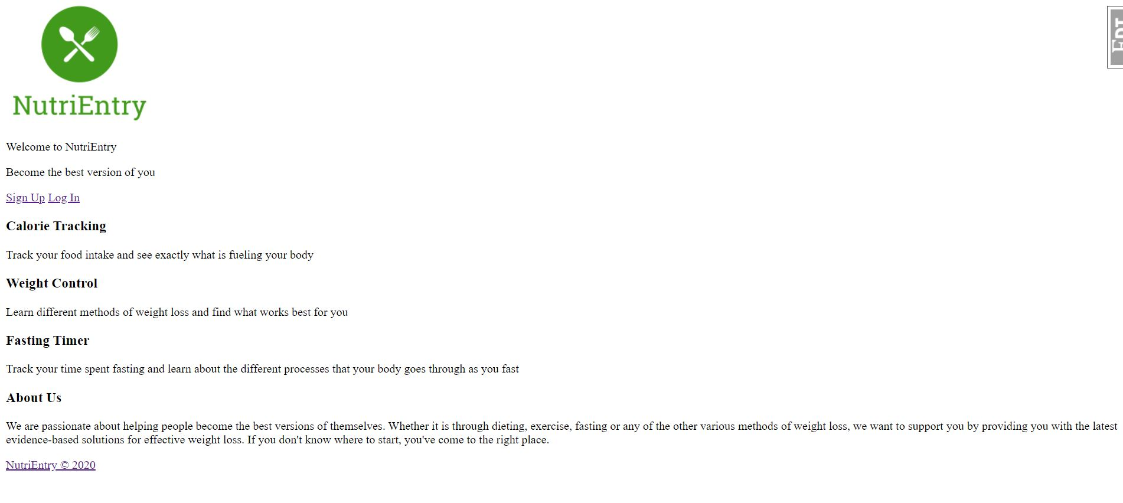
Landing Page with no CSS

Slide 4
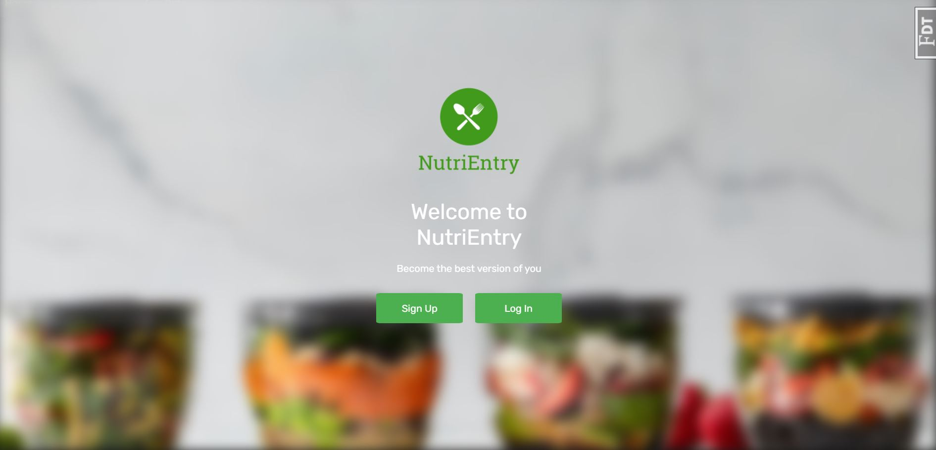
Landing Page with CSS

Slide 5
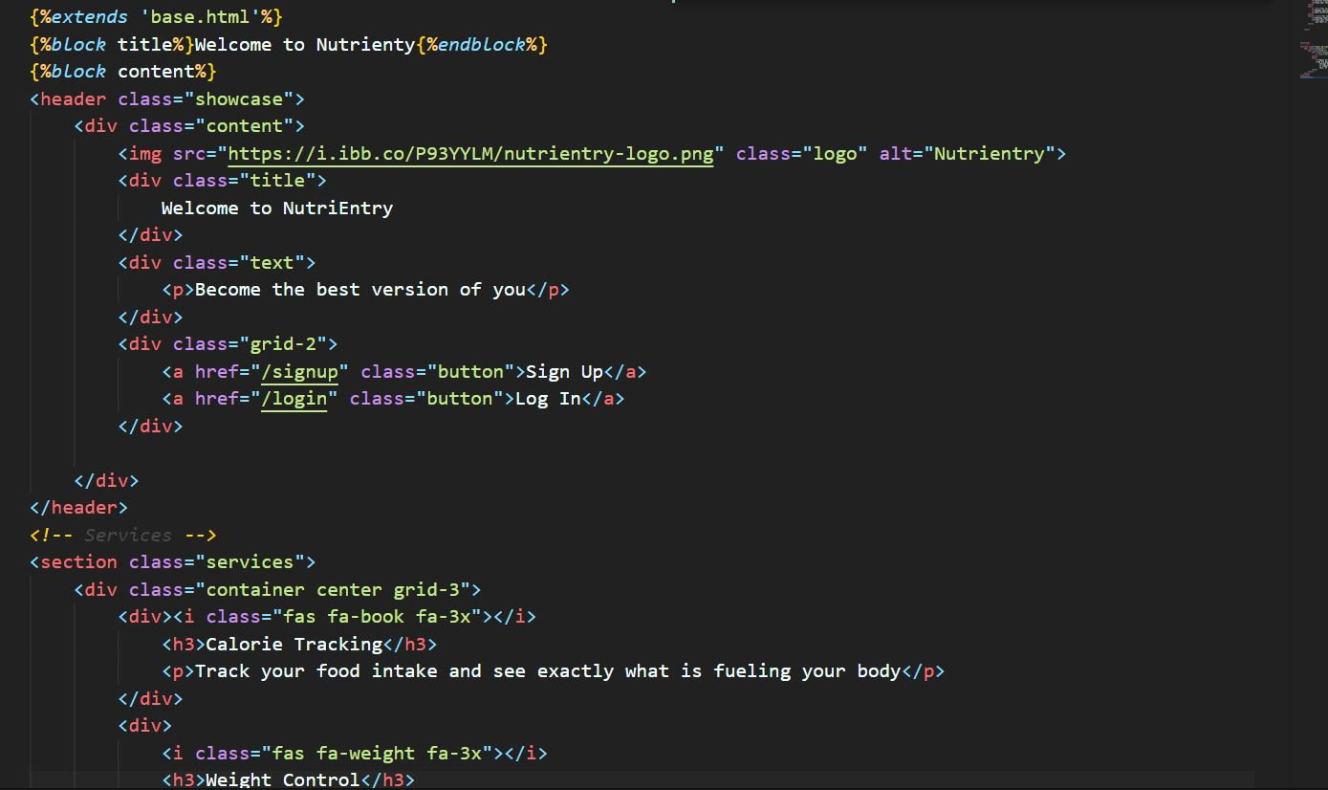
Landing Page Code

Slide 6
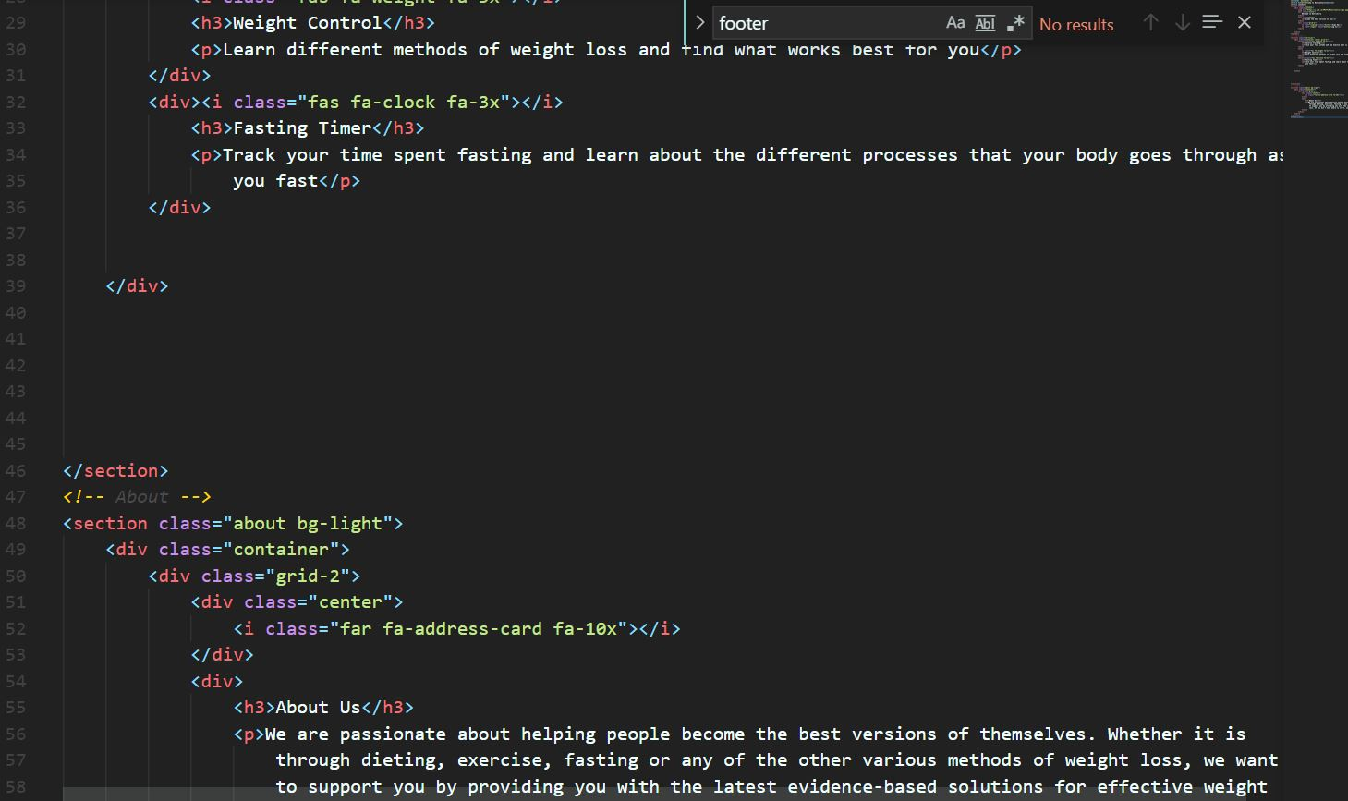
Landing Page Code (cont)

Slide 7
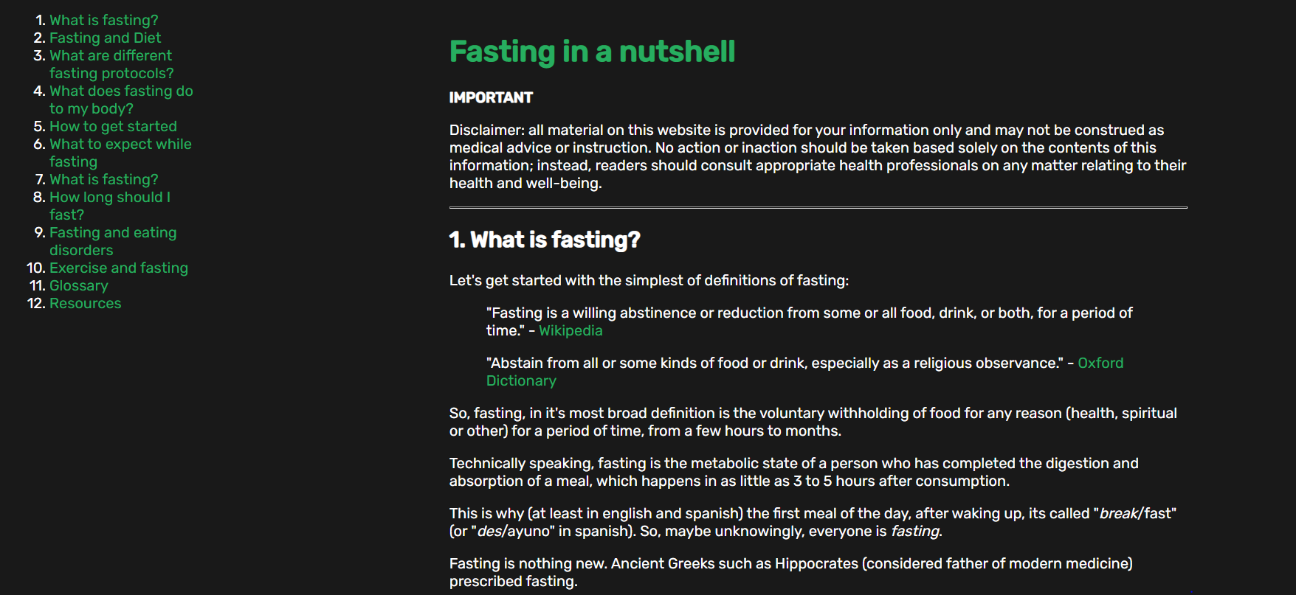
Learn about Fasting
I have a page where one can learn all about the benefits of Intermittent Fasting
There are many internal links on that page that lead to a specific question based on an FAQ
This page can be reached without Login

Slide 8
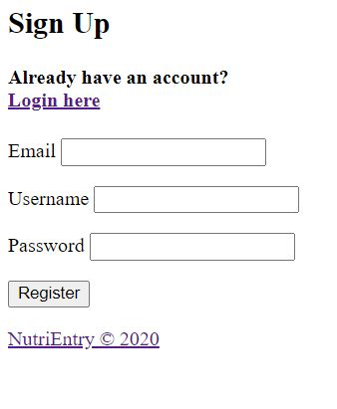
Sign Up Page
We have a form here that creates a user profile based off of the information provided. The username and password are used as part of the login

Slide 9
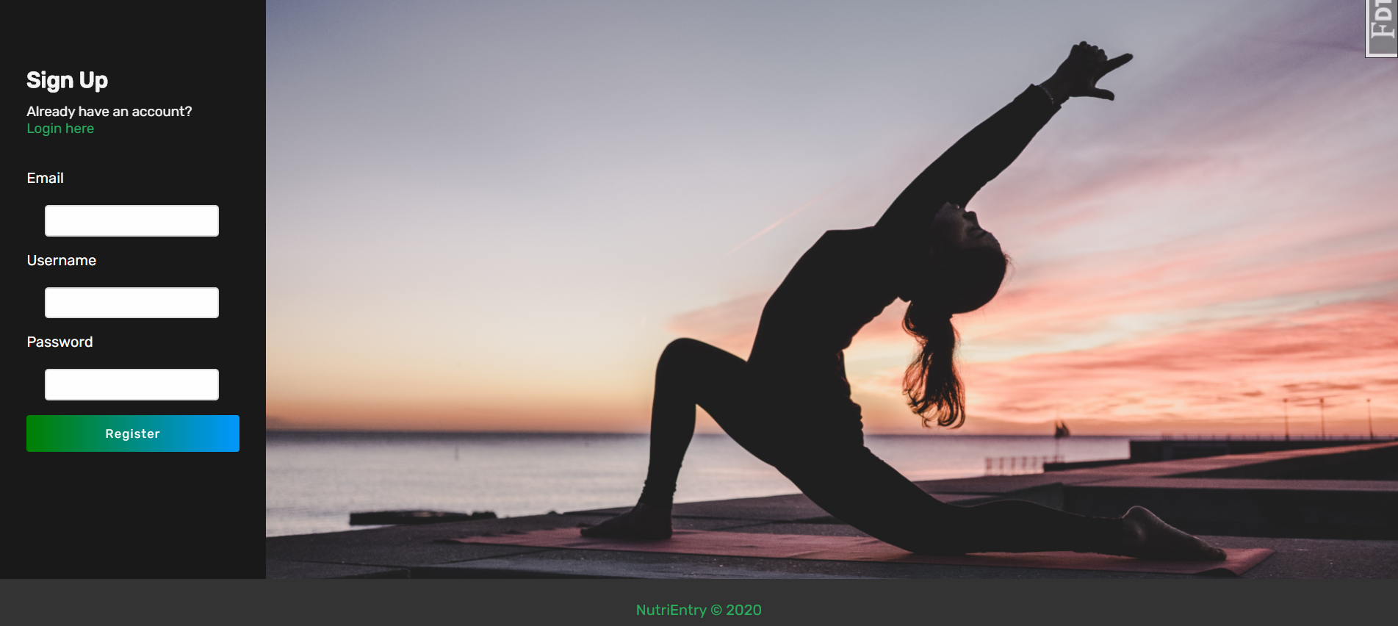
Sign Up Form with CSS

Slide 10
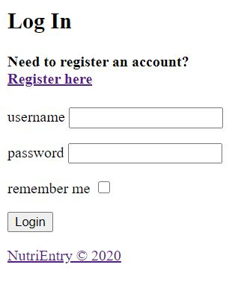
Login Page
Like the signup page except that we only require a username and password to login. If the user checks off remember me, they are saved into storage even after they click off of the site.

Slide 11
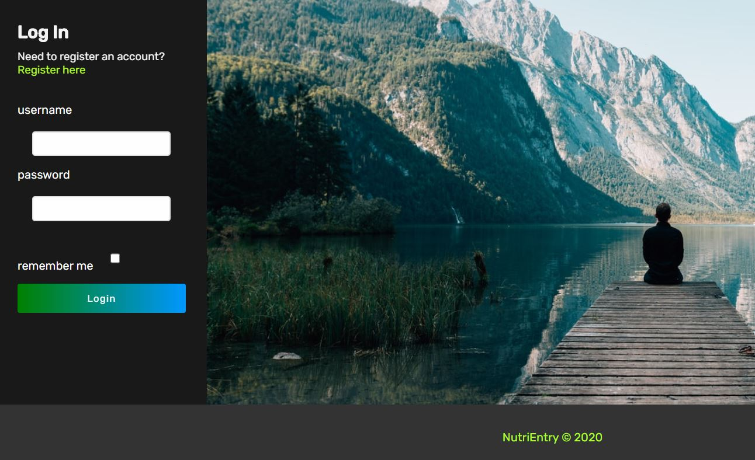
Login with CSS

Slide 12
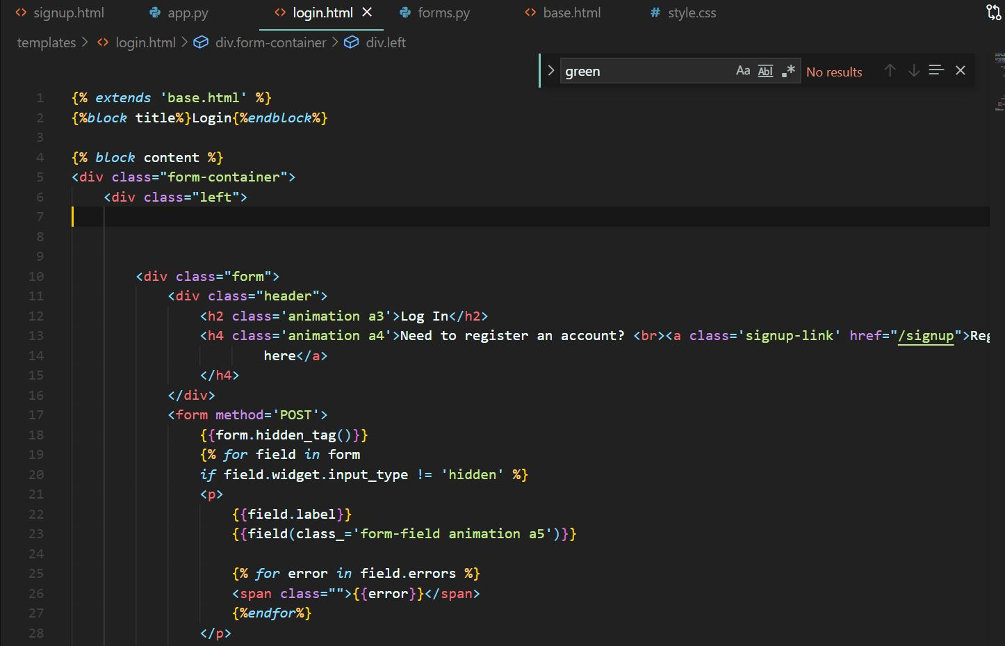
Login Code

Slide 13
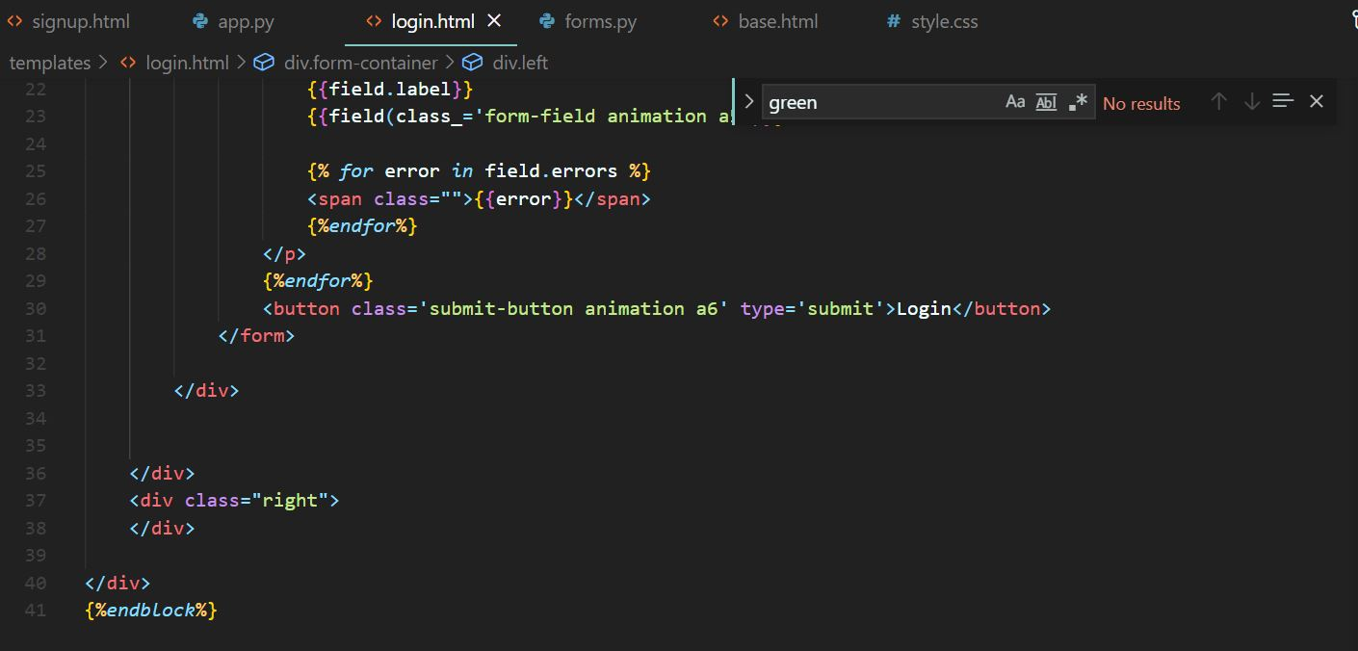
Login Code (cont)

Slide 14
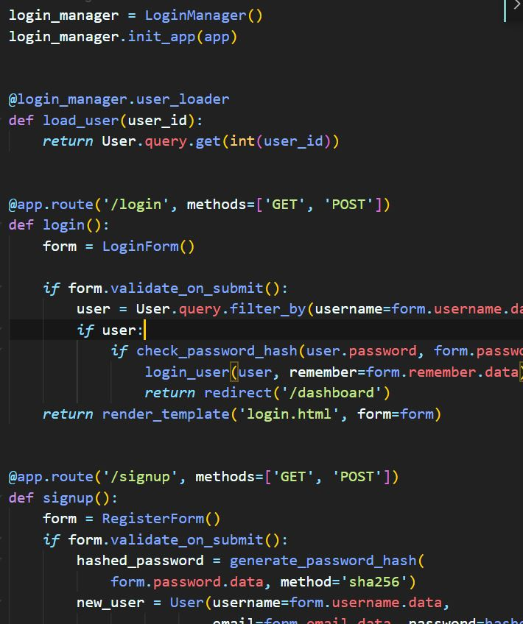
Login Functionality
We are using a python library called Flask_Login to create a login class and check if a user_id exists with a password combination that is valid. This lets us use a python decorator to indicate view functions that require login permissions.

Slide 15
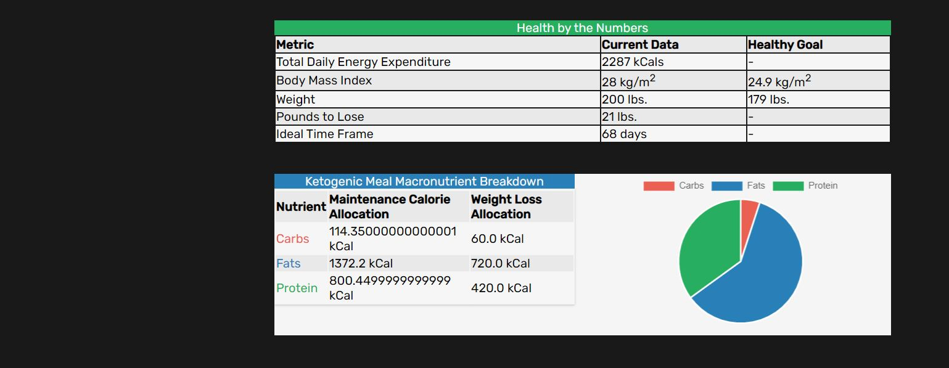
Health Stat Calculations
z

Slide 16
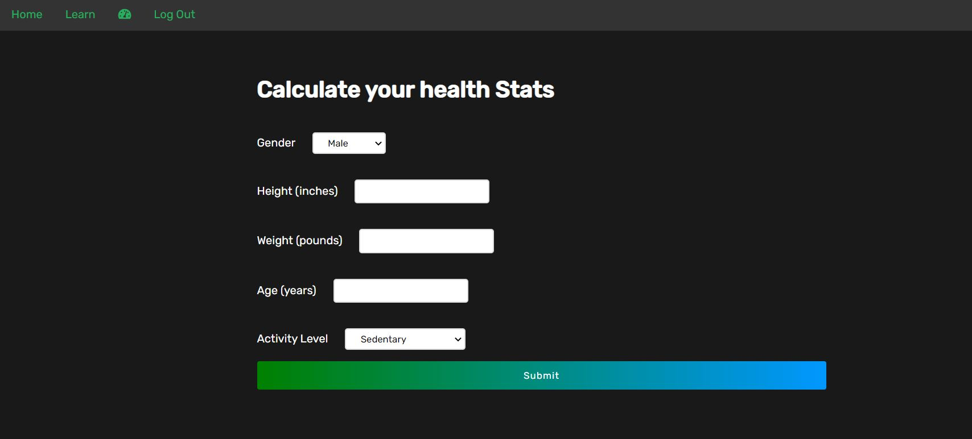
Health Stat Form

Slide 17
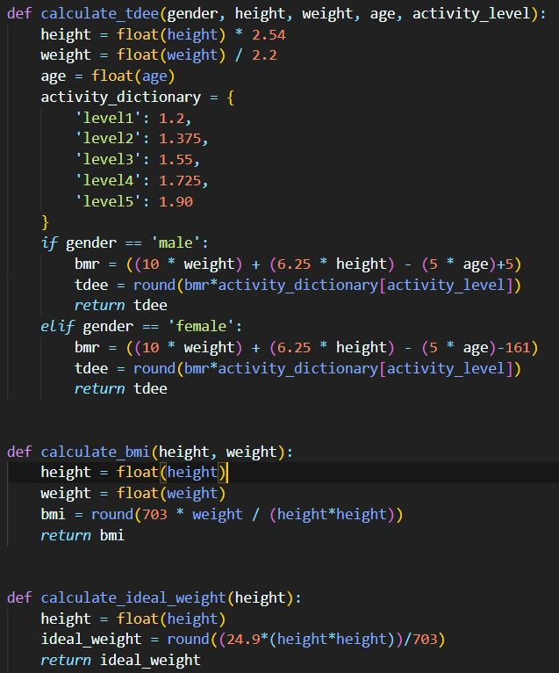
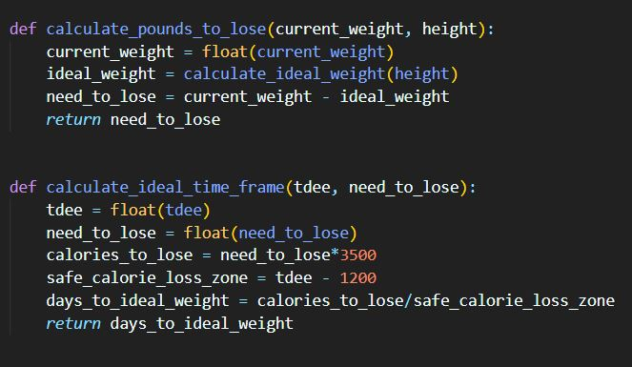
Health Metrics Logic

Slide 18
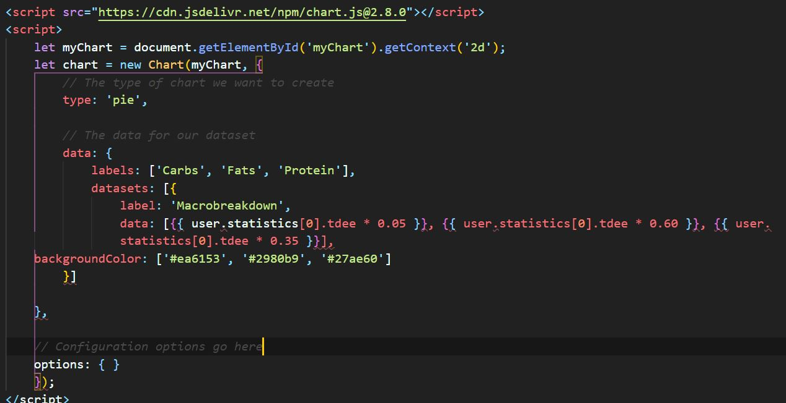
Java Script Graph Code

Slide 19
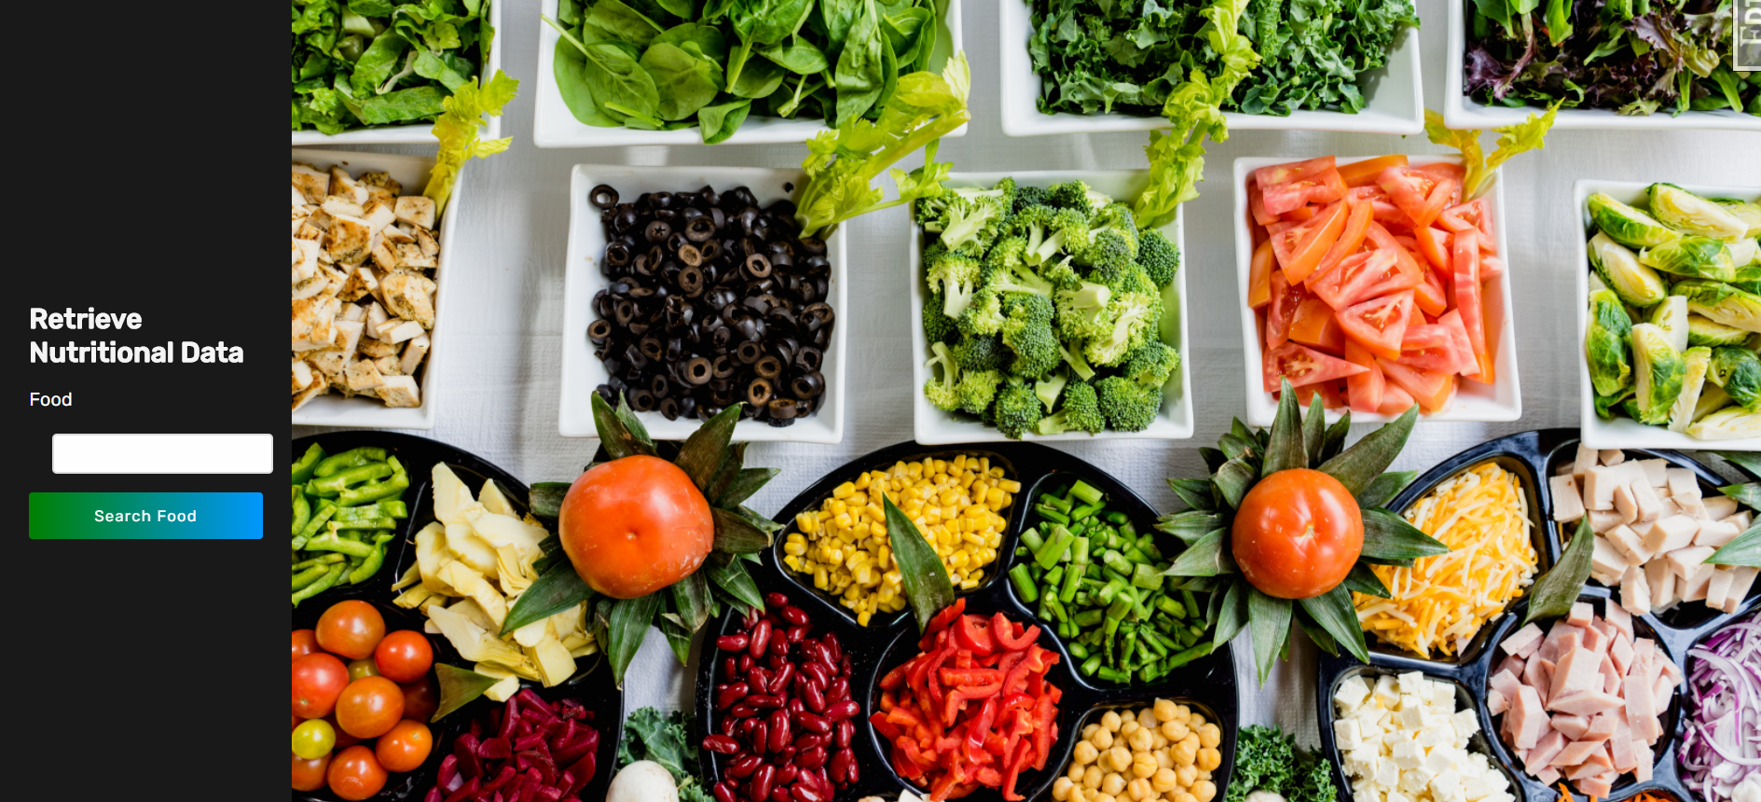
Food Search Page

Slide 20
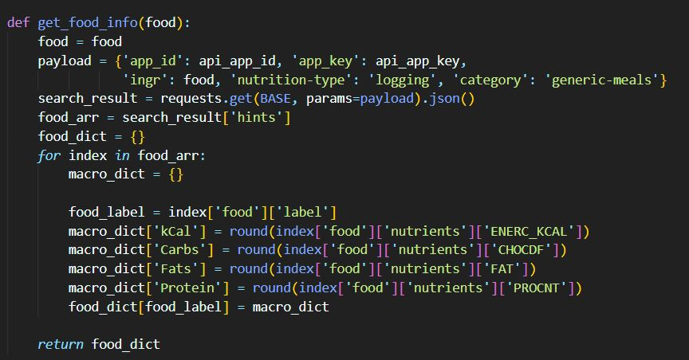
Food Search Request Logic
In order to be able to get data for a food search we need to reach out to an api.
I am using edamame to request nutritional data from food
I parse the data but first need to send a payload to tell the api exactly what food I would like to request

Slide 21
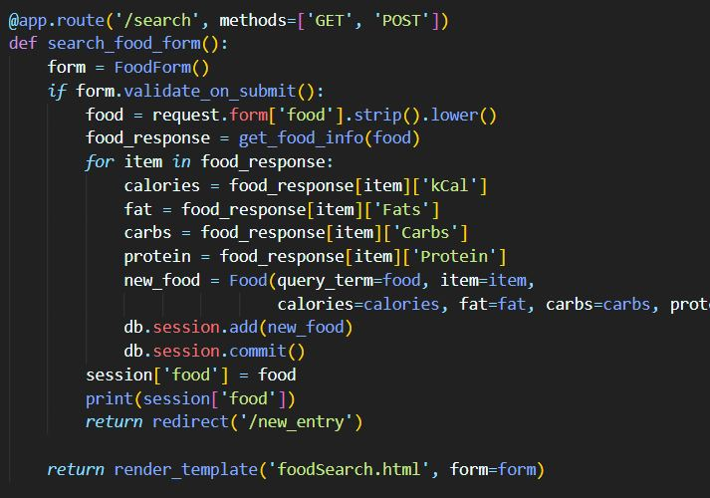
Search Logic
After I parse the information with my get_food_data function I want to be able to submit the information for all of that food to my database.
Set the required data from the SQL Alchemy Models and then I can submit the information to my database

Slide 22
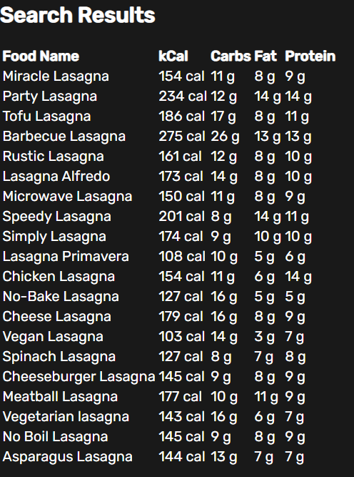
Search Results
These are the search results for Lasagna
The data is being generated by an API called Edamame
I am parsing and displaying the data that is most relevant to a user

Slide 23
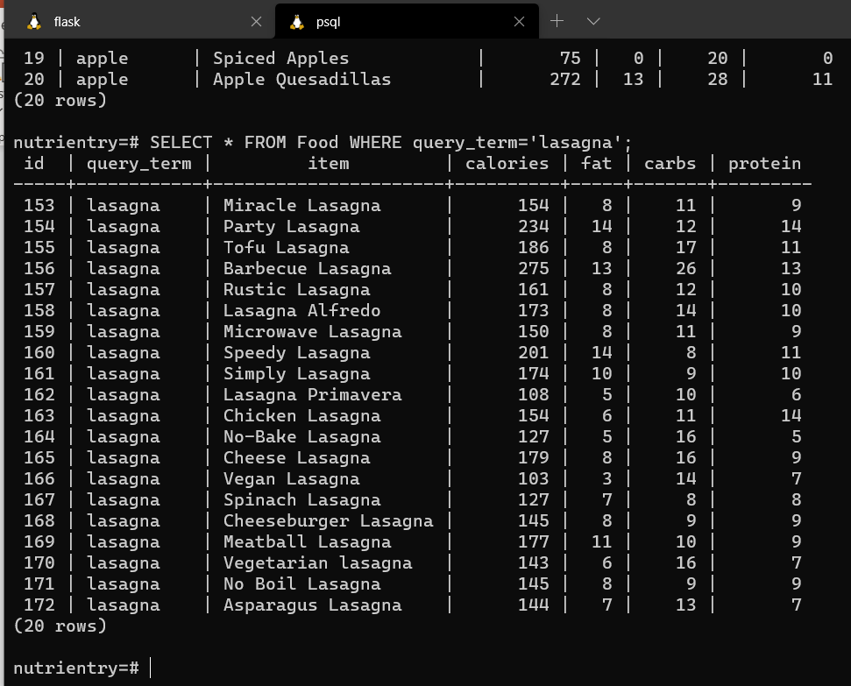
Data Capture
This is a screenshot of my database after doing that search
I am saving the foods that I get information for by using a common query term
If a query_term has already been searched by any user then I don’t need to make another API call and duplicate data

Slide 24
Next up
Features to be implemented soon:
Submitting food to your diary, tracking the nutritional data and subtracting the caloric intake from existing TDEE
Deployment on Heroku
Documentations and comments
The latest updates have brought in a variety of changes
Sign up page has been altered
Search food functionality has been implemented
A learning page has been added for users

Slide 25
Known Failures
There are some failures with my current design that I still need to fix:
Regarding certain routes I need to ensure that a login is required on most routes except the learning and landing pages.
A user should have a health stats summary before being able to submit a search for a food
I am currently not allowing a user to select a searched food to be able to submit a new health entry along with the date and food data
Duplicate food searches cause errors and crash the program
CSS needs a bit of an overhaul

Slide 26
Sources
Health Calculations : https://www.k-state.edu/paccats/Contents/PA/PDF/Physical%20Activity%20and%20Controlling%20Weight.pdf
Chart JS Library for Graphs: https://www.chartjs.org/
Flask sources: https://flask-login.readthedocs.io/en/latest/ https://flask.palletsprojects.com/en/1.1.x/
SQL Alchemy: https://docs.sqlalchemy.org/en/13/
Edamam: https://developer.edamam.com/food-database-api-docs

Slide 27
Thank you!
z

